Slide 2


Slide 3
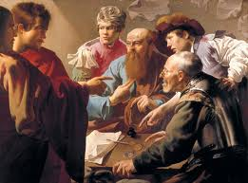
MARK 2:14-22
Parallel accounts in Luke 5:29-39; Matthew 9:9-17

Slide 4
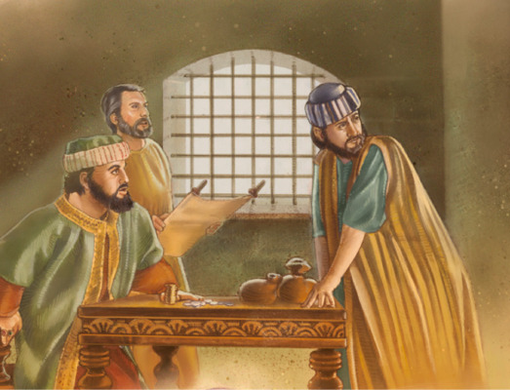
FOUNDATION FOR THE PARABLE
Matthew 9:14
Matthew 4:12; 11:2
Mark 2:18
Luke 5:32 “unto repentance”
2 Peter 3:9

Slide 5
THE BRIDEGROOM’S ATTENDANTS
“sons of the bride-chamber”
John 3:28,29 – Jesus the Bridegroom
Mark2:20
THE NEW AND THE OLD
Matthew 9:16
Things Which Do Not Harmonize Should Not Be Put Together

Slide 6
LUKE 5:39
"And no one, having drunk old wine, immediately desires new; for he says, 'The old is better.’”
Emphasis on slowness and reluctance of those under influence of rabbis to accept gospel
Have a taste for the OLD and resist the NEW!
Note: “HE” says “the old is better” – Jesus does not concur with this

Slide 7
HE GAVE THREE EXAMPLES:
1. A bridegroom’s guests do not fast while he is with them.
2. A new unshrunk patch is not put on an old garment because it will shrink and tear will be worse.
3. New wine is not put into old wineskins for as it ferments it will break the old skins, and both the skins and the wine will be ruined.

Slide 8
IN EACH CASE TWO THINGS DO NOT MIX:
1. A time of feasting and a time of fasting (vs. 34,35)
2. A new patch and an old garment (v. 36)
3. New and old wineskins (vs. 37,38)
His way and way of Pharisees are unmixable!
Pharisees assumed their OLD way was better!
Jesus’ teaching considered to be like new wine – and they wanted no part in it (v. 39)!

